Slide 1
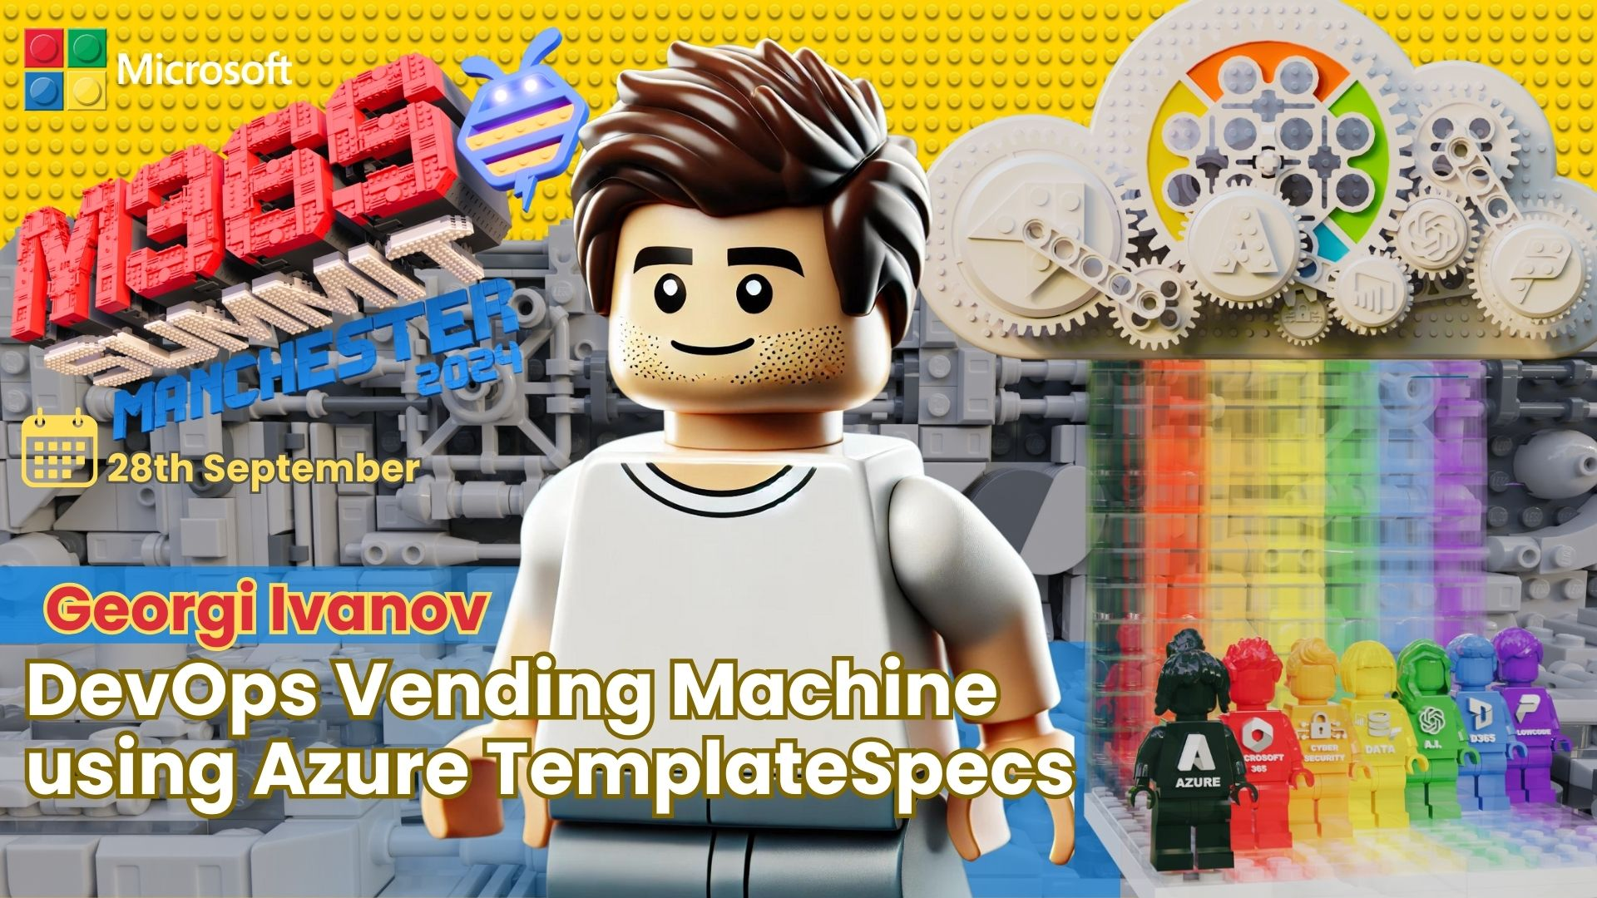

Slide 2
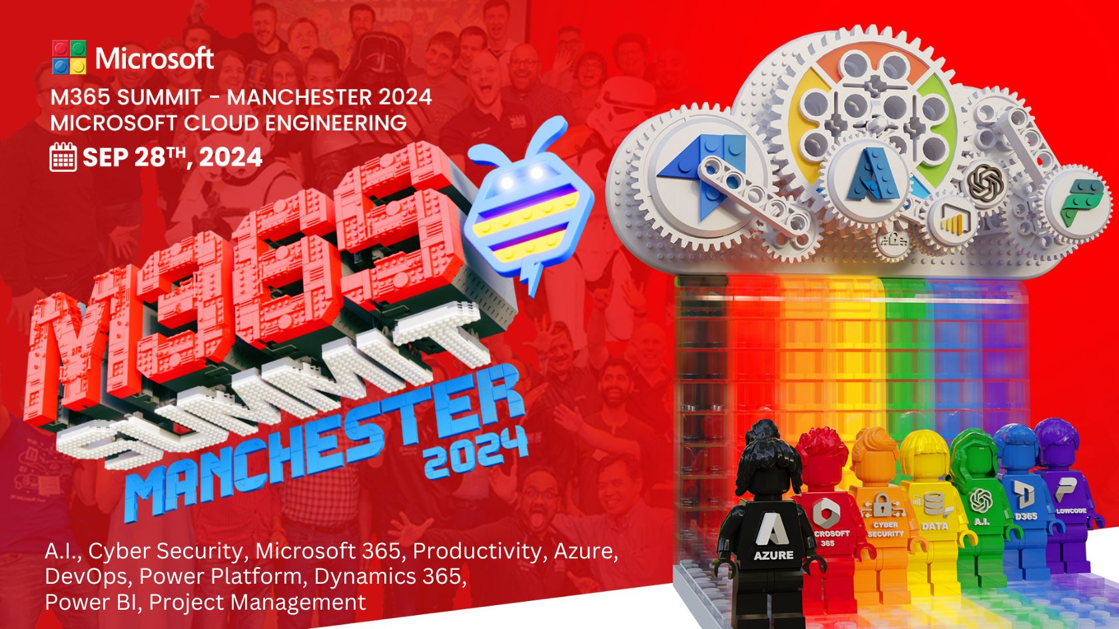

Slide 3
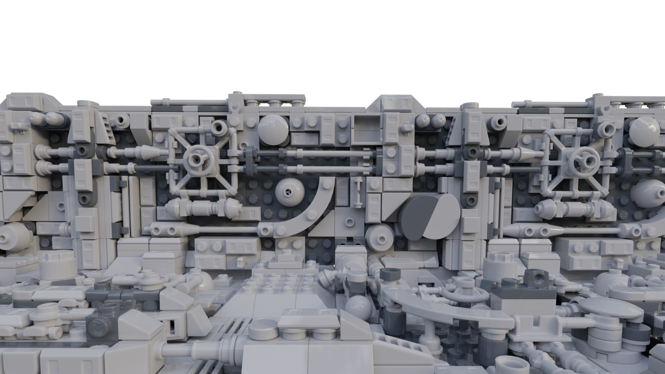
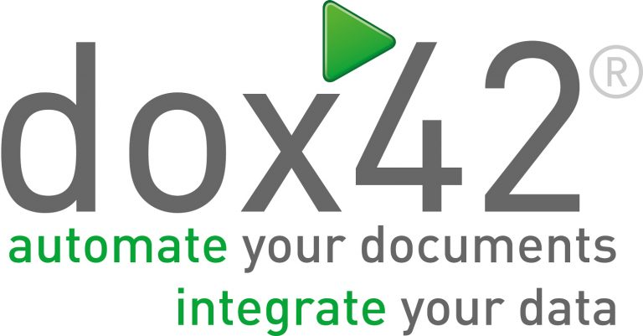







Sponsors
THANK
For having Me

Slide 4







Georgi Ivanov
IT Engineer trying to adopt to the ever-changing IT landscape.
Technology Lead Automation
Trainer
Speaker at PowerShell UG BG
github.com/gogbg

Slide 5
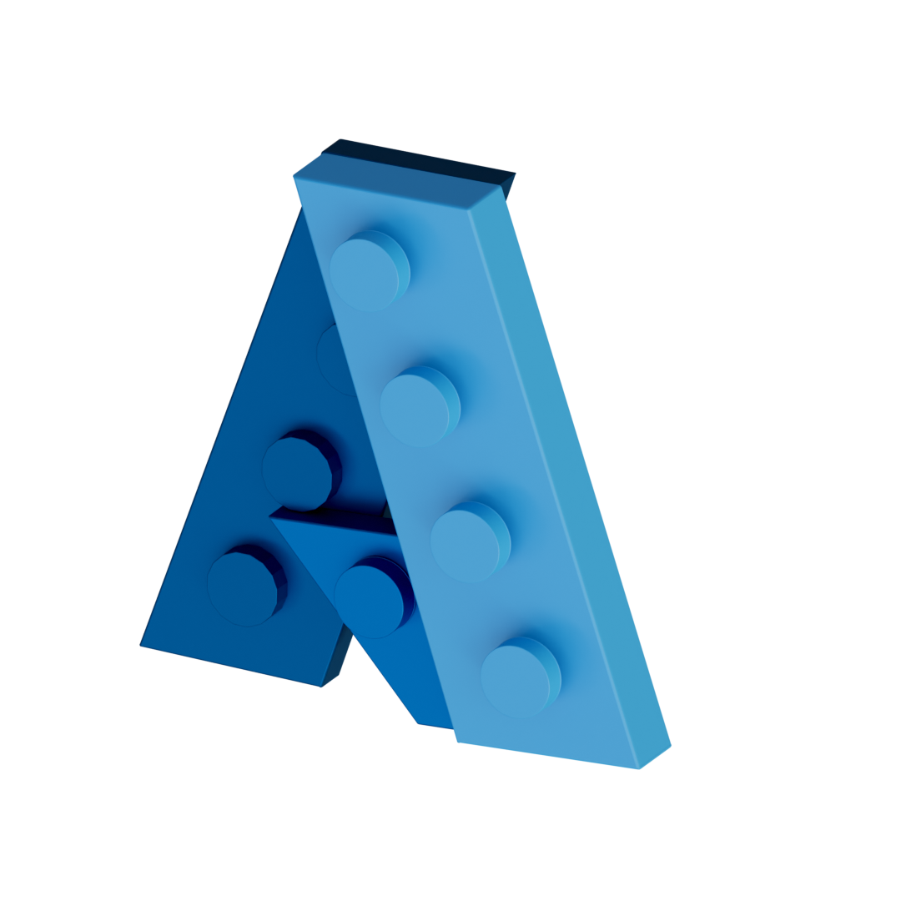

Agenda
Infrastructure management
GitOps
Azure Template Specs
Catalog
Template
User Interface
Conclusions
IaC
TS everywhere
Composition
TS for non prod
Deployment Options

Slide 6

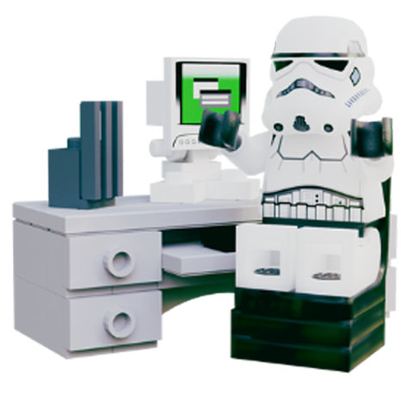

Expectations
What are the different applications of IaC
All examples are simplified
Why organization size/model matters
~ 28 slides and ~ 5 demos
Why Azure Template Specs can help
Based on stories in Azure
What might work for one organization might not for others

Slide 7


Infrastructure Management
IaC
GitOps
Catalog
Let’s look at the options…

Slide 8

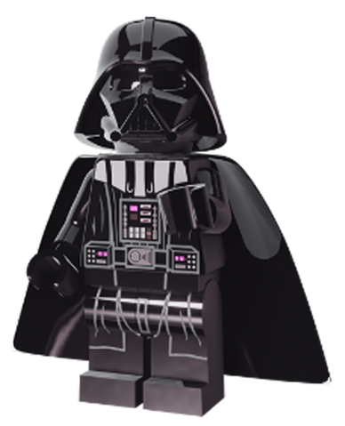
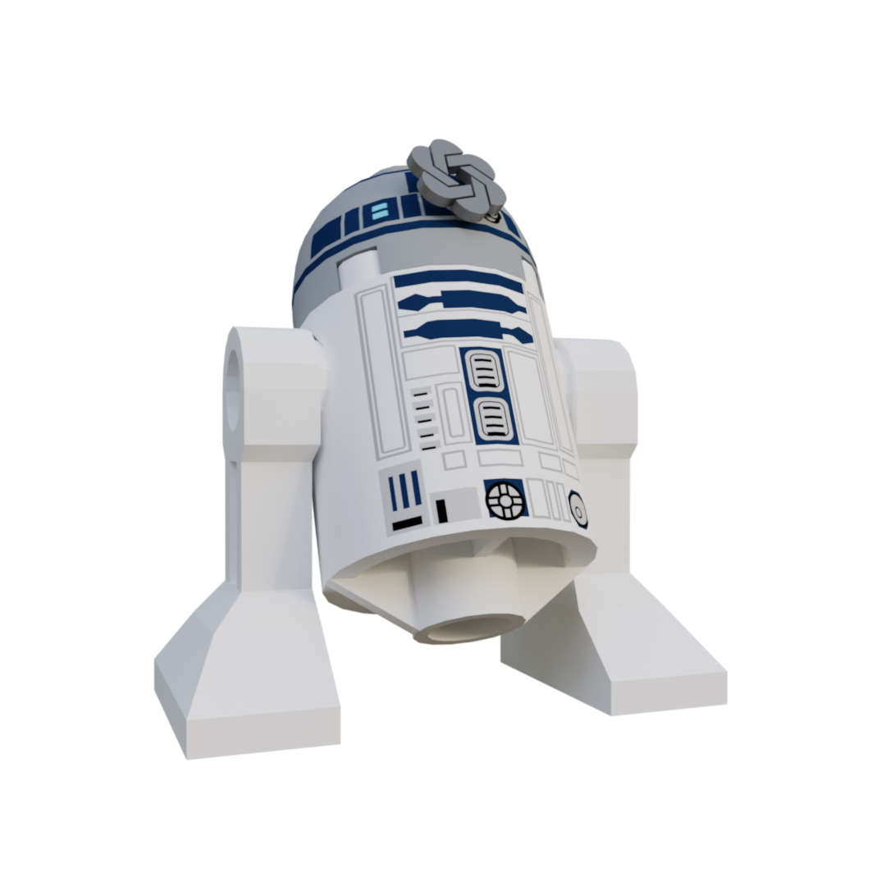
Infrastructure As Code (IaC) in practice
Infrastructure As Code (IaC) in practice
Takes proven coding practices to continuously deliver infrastructure, and software running on it rapidly and at scale.
To Whom?
Operations/Onboarding?
Key Principles
Source Control
Modularization and versioning
Idempotency
Immutability
CICD
Platform
Developers?
DevOps team?
LZ 1
LZ 1
LZ 1
Platform Team?
Other Systems?
Other Users?

Slide 9
But there are multiple IaC applications
Pipelines
Manually triggered on demand
GitOps
Auto triggered on PR merge
Catalog
Programmatically triggered on request

Slide 10

IaC using Pipelines
Who can live with it?
Does not require strict User RBAC
Scales well
Can be integrated with other systems
Other benefits from DevOps practice…
Limited Infrastructure change tracking
Limited Input types and validation
Environment inconsistency
Other cons as it is another
abstraction layer
DevOps team
Platform Team
Other Systems
Developers
Operations/Onboarding
Other Users
Notes:
Tell the story of KeyVault access mode switch issue investigation

Slide 11


IaC using GitOps
PR workflow
Who can live with it?
Change management as a code
Good change history
Does not require strict User RBAC
CI Pipelines can validate a lot
Environment consistency
Other benefits from DevOps practice…
Scale can be hard in siloed organizations
Very hard to integrate with other systems
Other cons as it is another abstraction layer
DevOps team
Platform Team
Developers
Operations/Onboarding
Other Users
Other Systems
Notes:
Tell the story of KeyVault access mode switch issue investigation

Slide 12
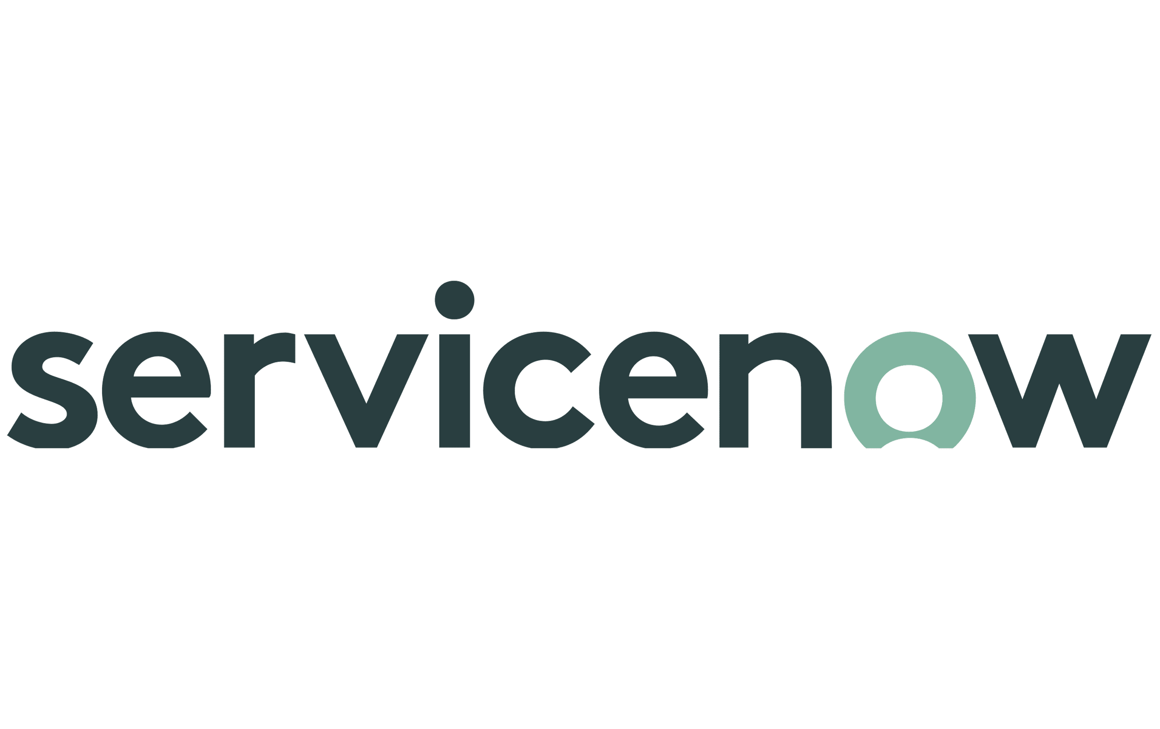
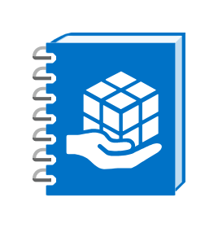
IaC using Service Catalog
Who can live with it?
DevOps team
Rich User Interface
Does not require strict User RBAC
High effort
Typically, Catalog servers only stable envs
Limited Infrastructure change tracking
Environment inconsistency
Platform Team
Developers
Operations/Onboarding
Other Users
Other Systems
Notes:
Tell the story of KeyVault access mode switch issue investigation

Slide 13
Infrastructure in complex environnements
Probably there are ton of other considerations, but the point is…
There are Pros and Cons in every model…
So hybrid approach might be necessary
What if … there was a tool that fits all scenarios….
supports Pipelines
provides Rich UI
Is reusable by other Templates
Integrates with other systems via API
Let's check Azure Template Specs…

Slide 14
Azure Template Specs
Template
User Interface
Deployment Options
Composition
Let’s explore…

Slide 15

Demo
Azure Template Spec
Azure resource type for storing an ARM/Bicep template for later deployment
/bicepModules/…
/pipelines/TS-CI.yaml
/templateSpecs/.../<name>.bicep
/pipelines/TS-CD.yaml
Platform
/scripts/TS-CD.ps1
Hub
LZ 1
LZ 1
LZ 1

Slide 16

Demo
Azure Template Spec Custom UI
By default, the Portal will create a simple user experience. To provide a richer, more robust experience you can create your own for Azure Portal deployments.
/bicepModules/…
/pipelines/TS-CI.yaml
/templateSpecs/…/<name>.bicep
/pipelines/TS-CD.yaml
/templateSpecs/…/<name>.ui.json
Platform
/scripts/TS-CD.ps1
Hub
LZ 1
LZ 1
LZ 1

Slide 17
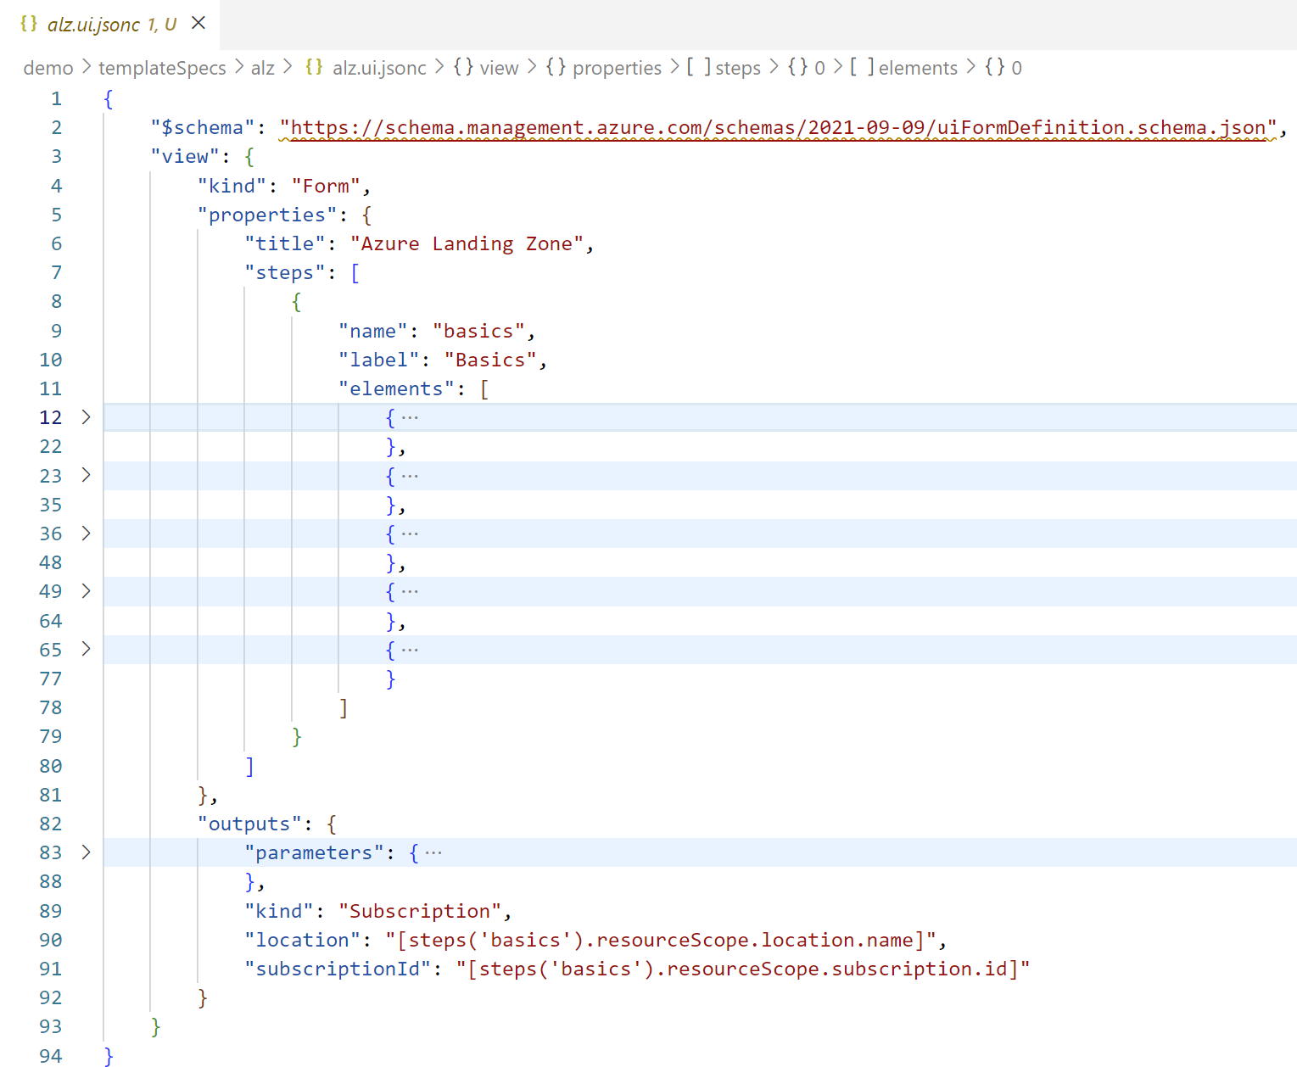
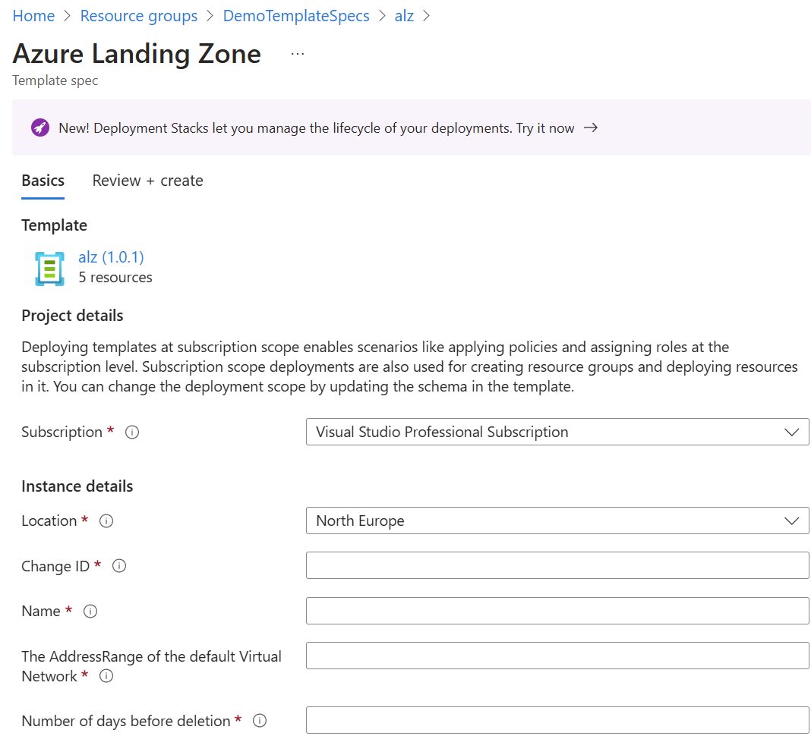
Azure Template Spec Custom UI structure
Tabs
Input fields
Ui input fields to template param bindings
Deployment controls

Slide 18
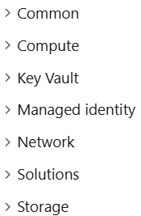
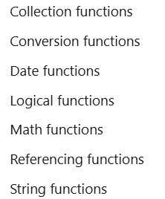
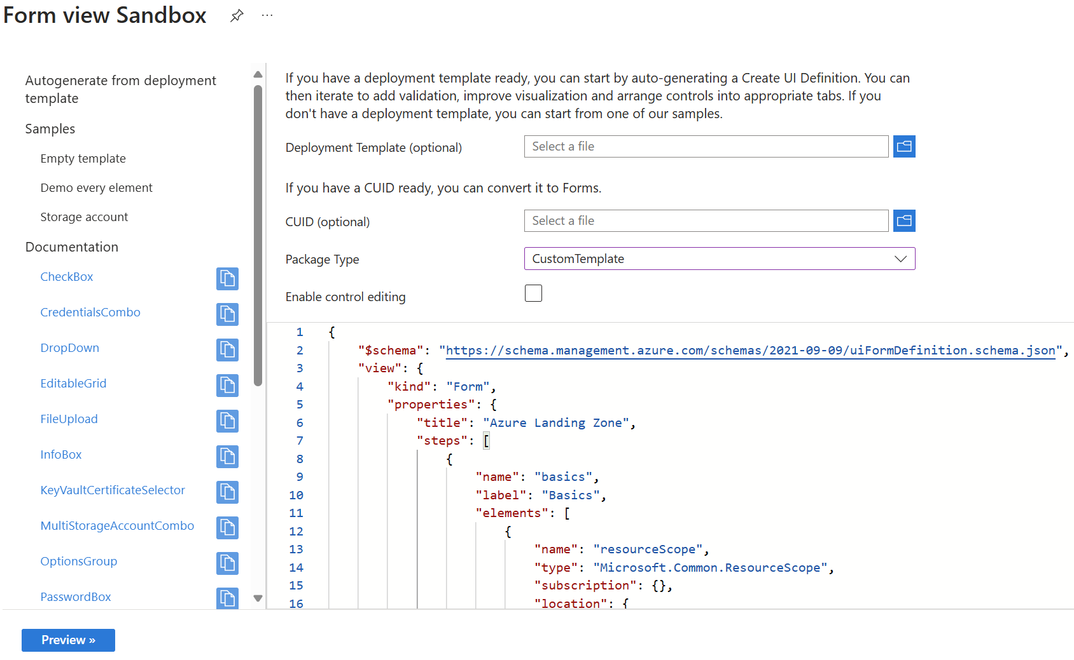
Azure Template Spec Custom UI elements
User interface elements
User interface functions
Sandbox utility

Slide 19
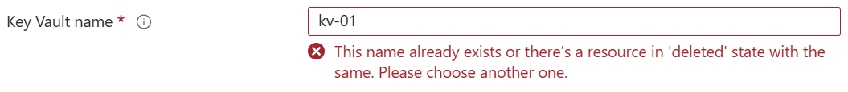
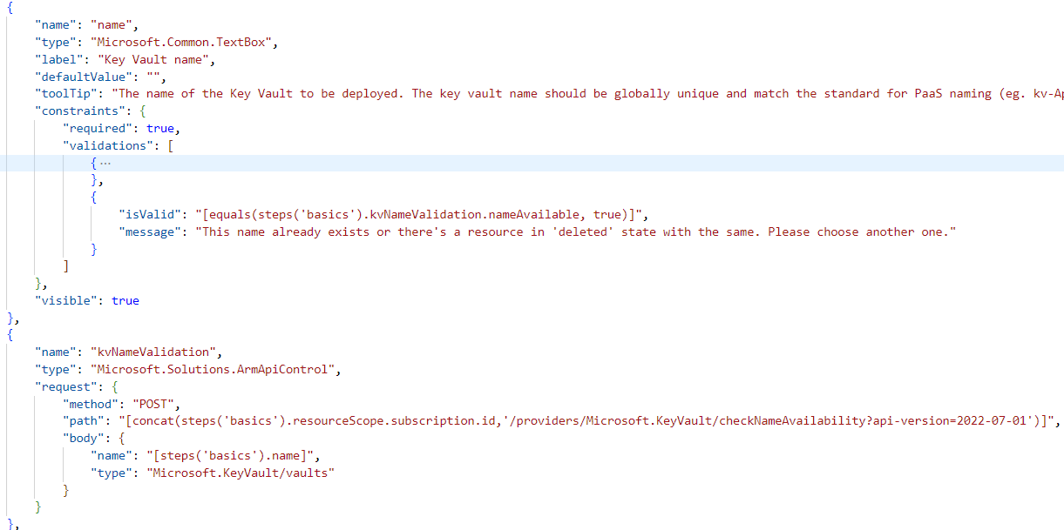
Demo
Azure TS UI calls to Azure RM
The: Microsoft.Solutions.ArmApiControl
reference to request result
request path. host is: management.azure.com
request body

Slide 20
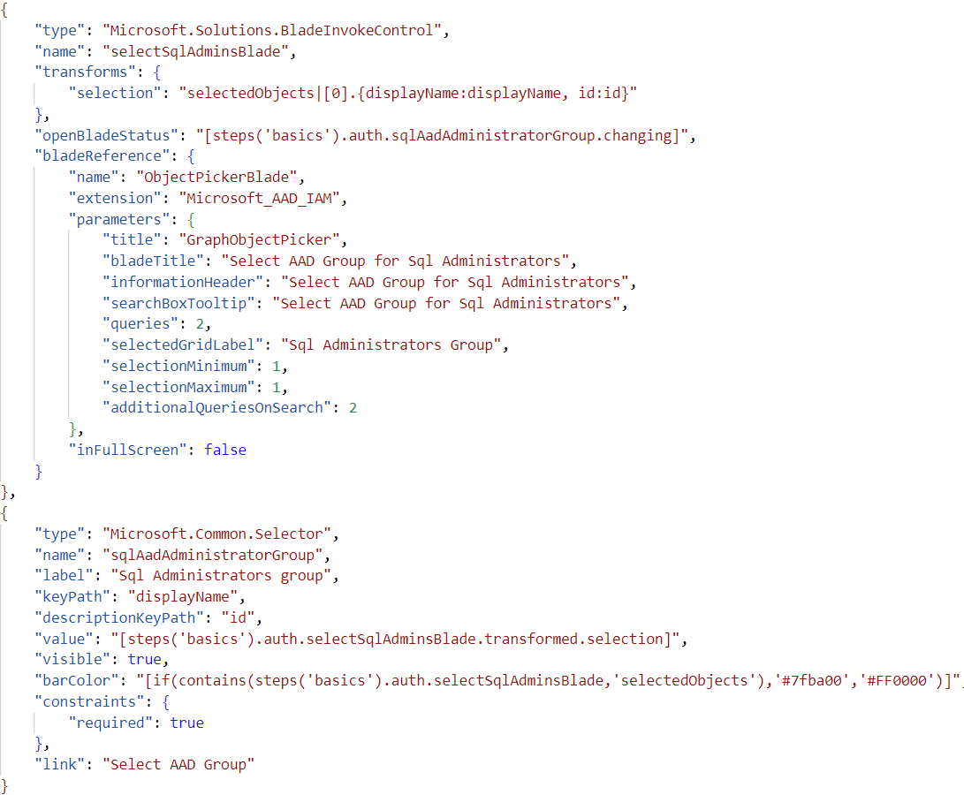
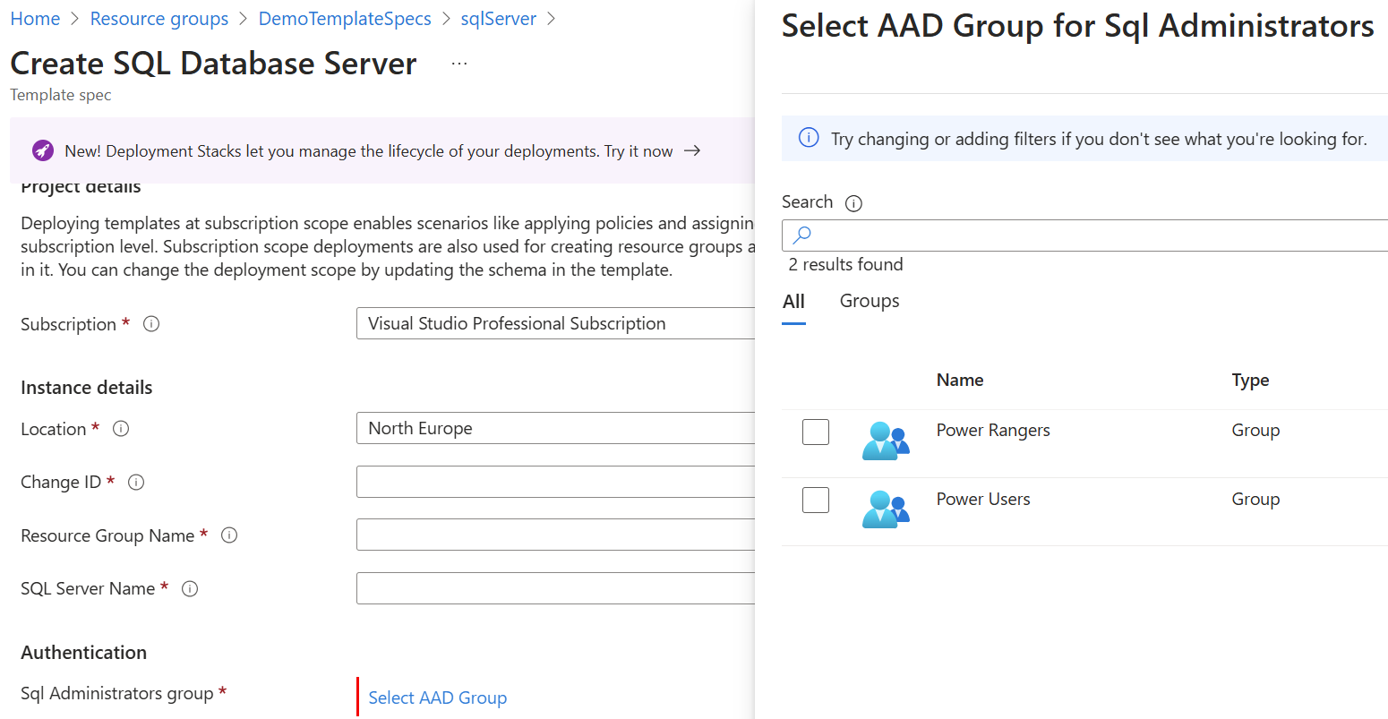
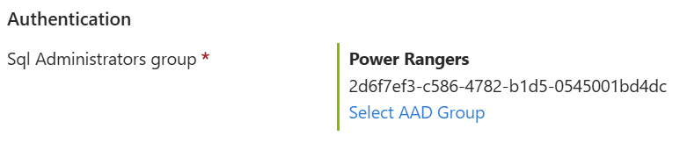
Demo
Azure Template Spec UI to Entra ID
Inspecting the schema, we can find “Microsoft.Solutions.GraphApiControl”, or even cooler “Microsoft.Solutions.BladeInvokeControl”
Transform blade output using JMESPath
When should blade open
Which blade
Blade settings
value from transformed blade output
UI element color

Slide 21
Azure Template Spec Custom UI blades
Blades are also described in the GitHub azure/portaldocs repo
How to use Azure Portal blades in the Template Specs UI (gatevnotes.com)
How to uncover the names and parameters of blades in Azure Portal (gatevnotes.com)

Slide 22



Azure Template Spec deployment options
Now that we know what Azure Template Specs are, lets check how can they be used.
Portal Users
Rest API
Task: AzureResourceManagerTemplateDeployment
PowerShell
Task: AzurePowerShell
Bicep/Arm Templates

Slide 23
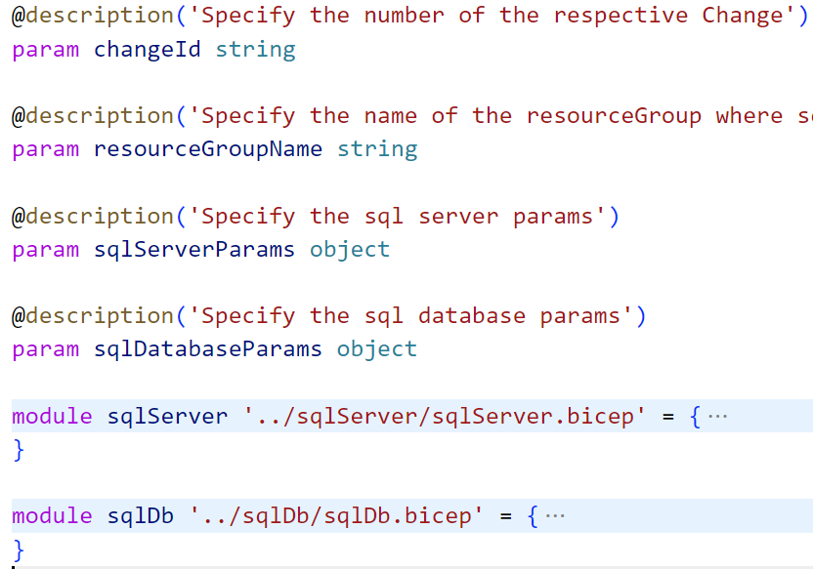
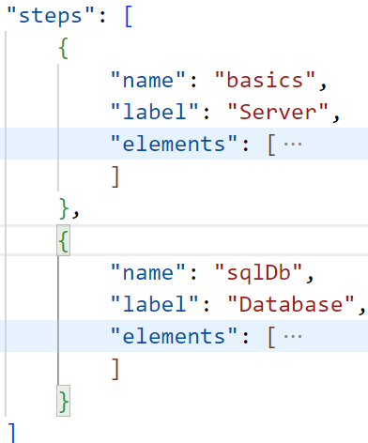
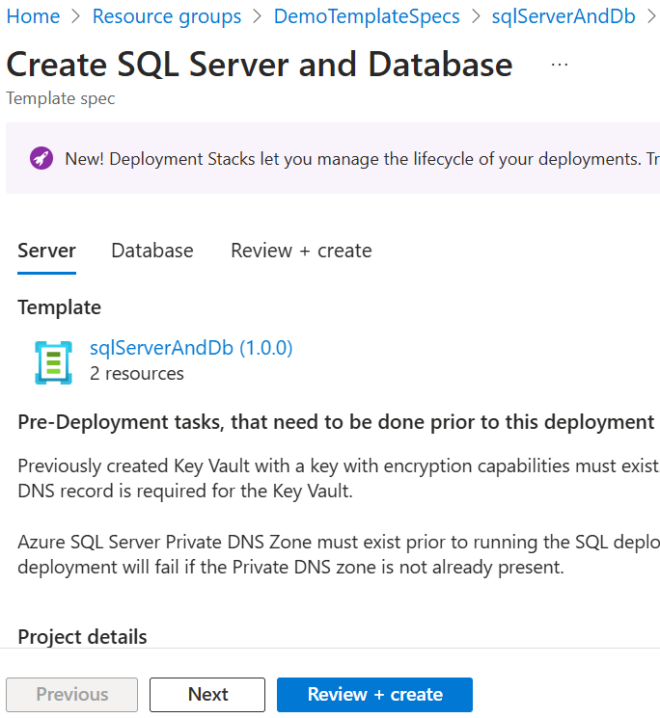
Demo
Azure Template Spec UI composition
But what about more complex deployments, like Applications that consists of multiple standardized resources?
Use UI Tabs as composition elements
Use Resource Template Spec's bicep files as modules in the Application bicep file
/ts/sqlServer
/ts/sqlDb
/ts/sqlServerAndDb

Slide 24
Azure Template Spec pros and cons
Rich UI for Portal Users
Better Input validation
UI development does not require SoftDev skills
Supports versioning with release notes
Idempotency-er (dependencies are always statically included)
No Bicep registry needed for distribution
Universal piece of the IaC puzzle
Portal User identity and RBAC used
Portal UI does not support Deployment Stacks
Initial deployment cannot be named
JSON UI definition complicates with scale
Portal User identity and RBAC used (might be tricky to refine RBAC)

Slide 25
Conclusions
TS everywhere
TS for non prod
How applicable are they…

Slide 26
Azure Template Spec everywhere
What does that means? – UI form development might be unnecessary in large enterprises
Strict User RBAC is very hard in large enterprises
Portal Users
Platform
Use Template Specs instead of Bicep Registry
template.ui.json
template.bicep
LZ# prd
LZ# stg
Pipelines/API
LZ# sandbox
LZ# dev

Slide 27
Azure Template Spec for non-prod
What does that means? – Something developed in dev/sandbox has a high change to work in stg and prd
Relaxed RBAC even in large enterprises non prod environments
Portal Users
Platform
For platform, prd, and stg environments
template.ui.json
template.bicep
LZ# prd
LZ# stg
Pipelines/API
LZ# sandbox
LZ# dev

Slide 28

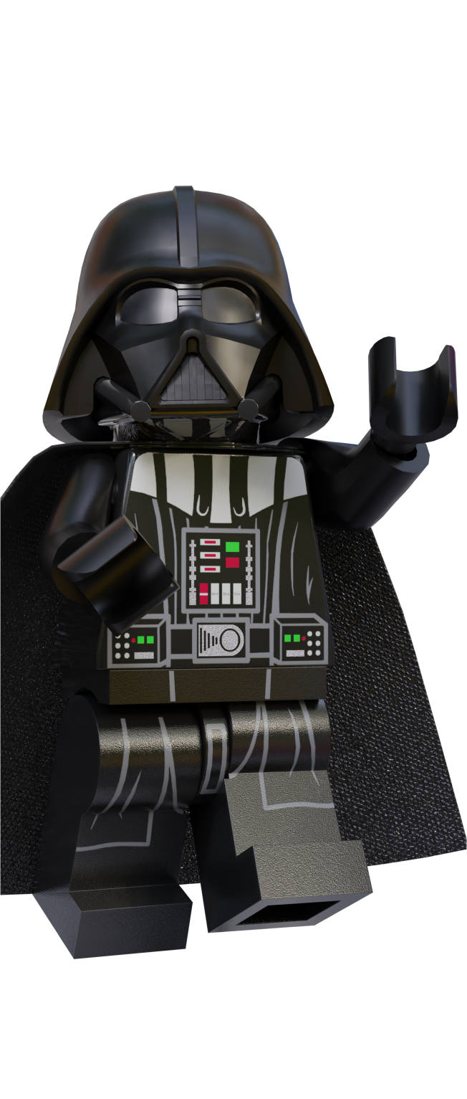


Questions

Slide 29
Sponsors
THANK
YOU!

